Slide 1
Chapter 12 - JavaScript: Objects
Outline
12.1 Introduction
12.2 Thinking About Objects
12.3 Math Object
12.4 String Object
12.4.1 Fundamentals of Characters and Strings
12.4.2 Methods of the String Object
12.4.3 Character-Processing Methods
12.4.4 Searching Methods
12.4.5 Splitting Strings and Obtaining Substrings
12.4.6 XHTML Markup Methods
12.5 Date Object
12.6 Boolean and Number Objects
12.7 document Object
12.8 window Object
12.9 Using Cookies
12.10 Final JavaScript Example
12.11 Web Resources

Slide 2
12.1 Introduction
Use JavaScript to manipulate every element of XHTML document from a script
Reference for several of JavaScript’s built-in objects
Demonstrates the capabilities

Slide 3
12.2 Thinking About Objects
Objects
  Attributes
  Behaviors
  Encapsulate date and methods
  Property of information hiding
  Details hidden within the objects themselves

Slide 4
12.3 Math Object
Allow the programmer to perform many common mathematical calculations

Slide 5
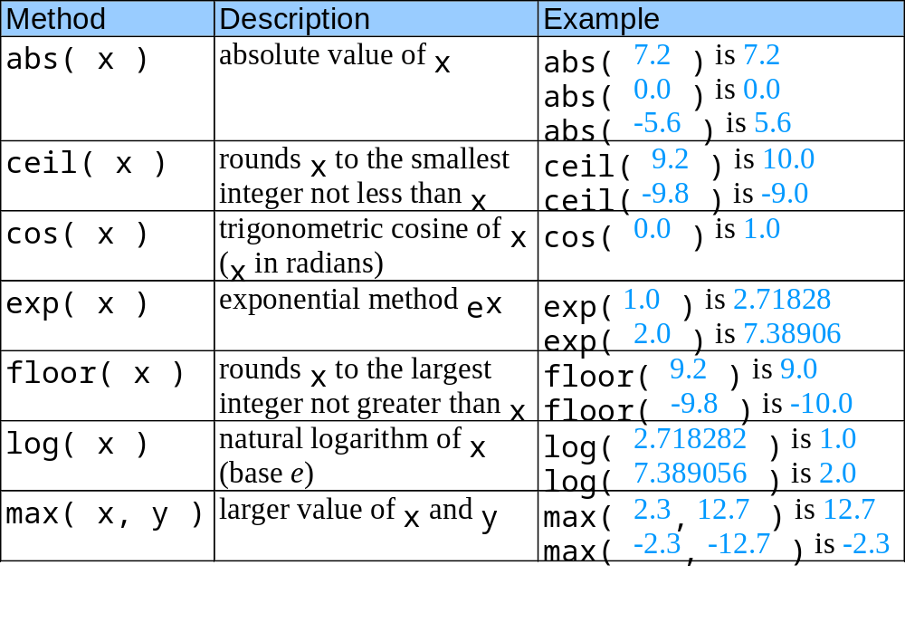
12.3 Math Object
Fig. 12.1 Math object methods.

Slide 6
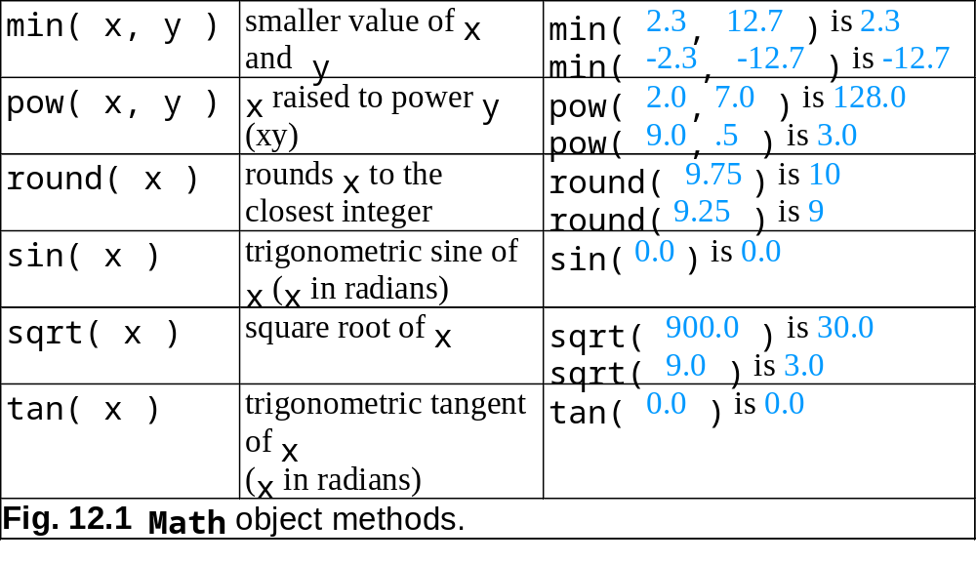
12.3 Math Object

Slide 7
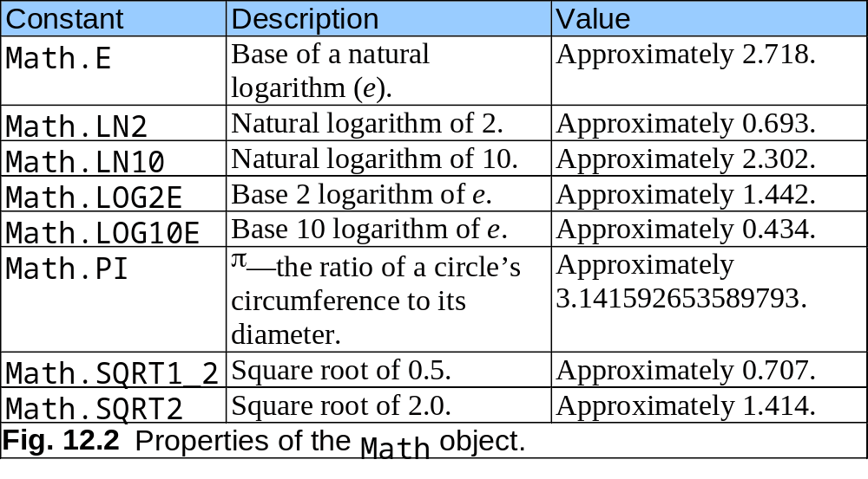
12.3 Math Object

Slide 8
12.4 String Object
JavaScript’s string and character-processing capabilities
Appropriate for processing names, addresses, credit card information, etc.

Slide 9
12.4.1 Fundamentals of Characters and Strings
Characters
  Fundamental building blocks of JavaScript programs
String
  Series of characters treated as a single unit

Slide 10
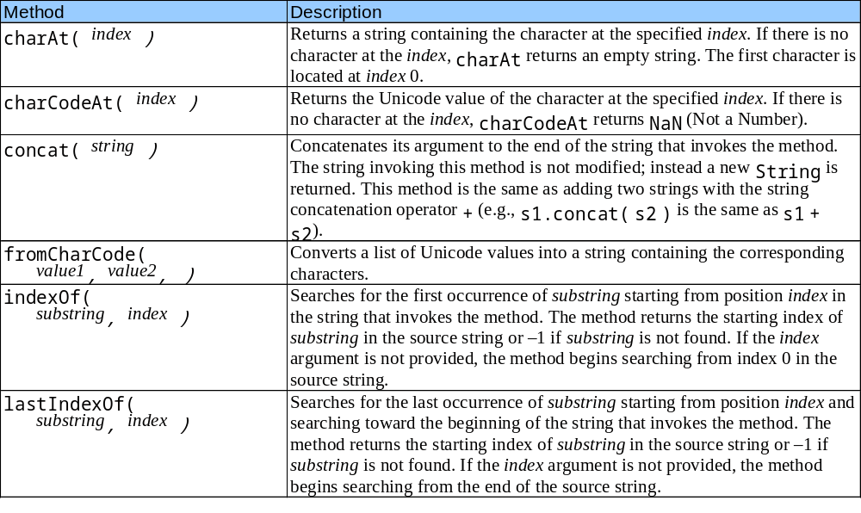
12.4.2 Methods of the String Object
Fig. 12.3 String object methods.

Slide 11
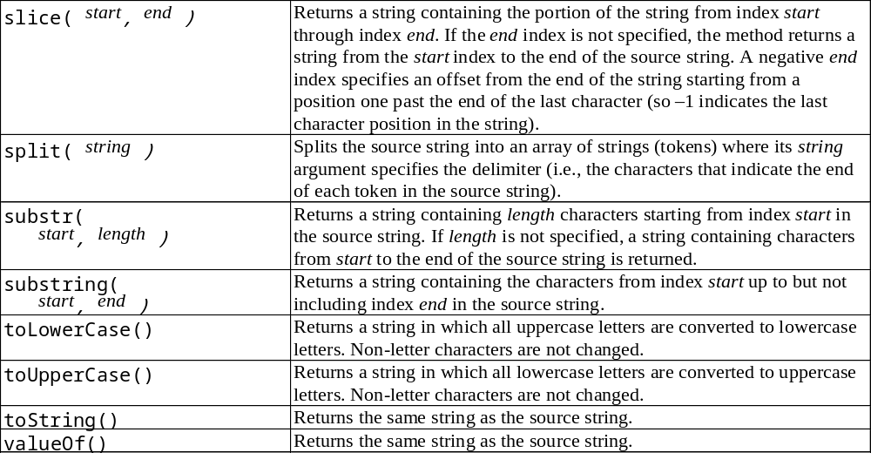
12.4.2 Methods of the String Object
Fig. 12.3 String object methods.

Slide 12
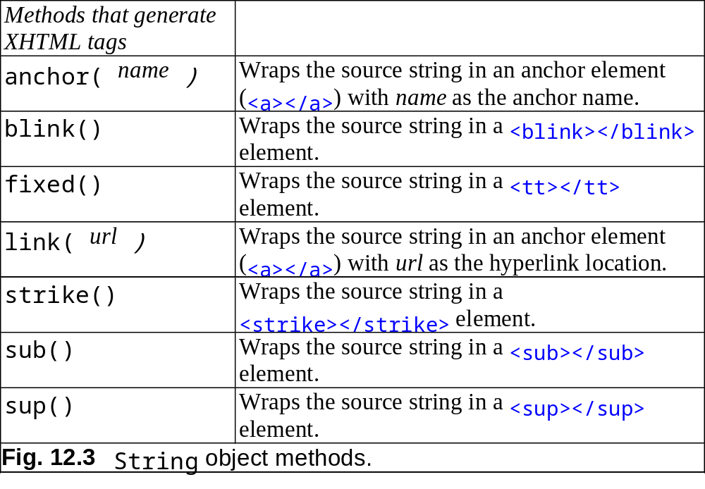
12.4.2 Methods of the String Object

Slide 13
12.4.3 Character Processing Methods
charAt
  Returns the character at specific position
charCodeAt
  Returns Unicode value of the character at specific position
fromCharCode
  Returns string created from series of Unicode values
toLowerCase
  Returns lowercase version of string
toUpperCase
  Returns uppercase version of string

Slide 14
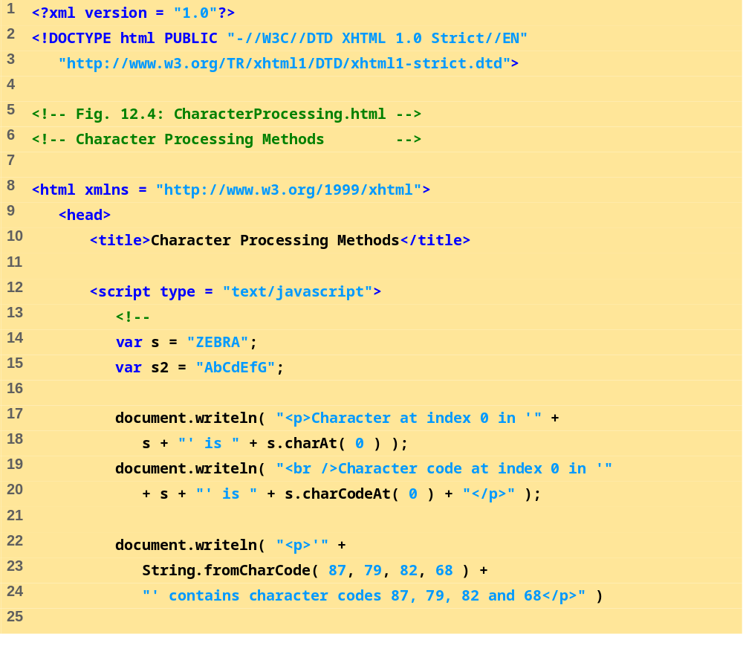
CharacterProcessing.html
1 of 2

Slide 15
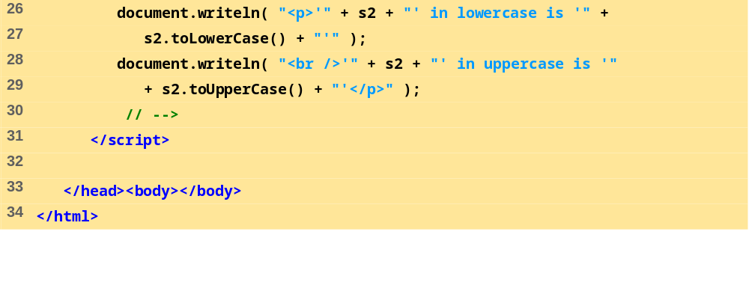
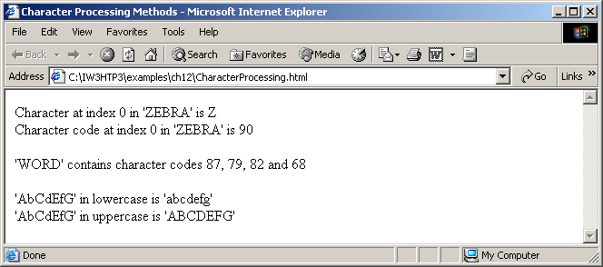
CharacterProcessing.html
2 of 2

Slide 16
12.4.4 Searching Methods
indexOf and lastIndexOf
  Search for a specified substring in a string

Slide 17
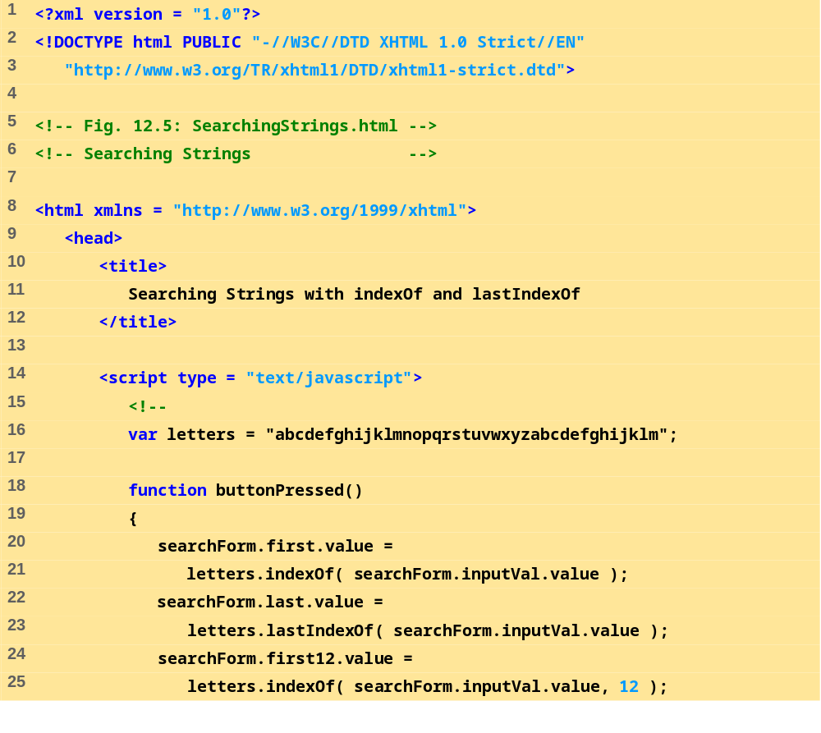
SearchingStrings
.html
1 of 3

Slide 18
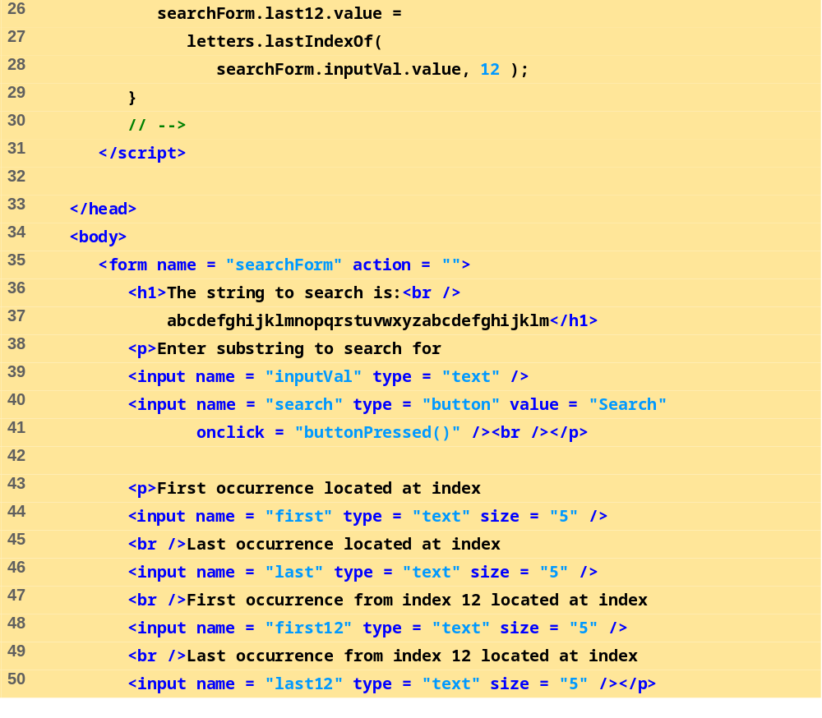
SearchingStrings
.html
2 of 3

Slide 19
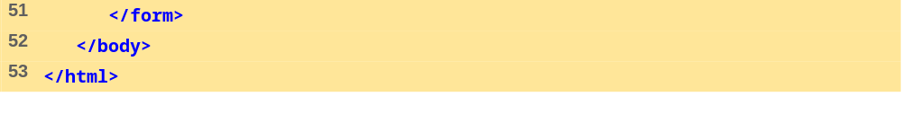
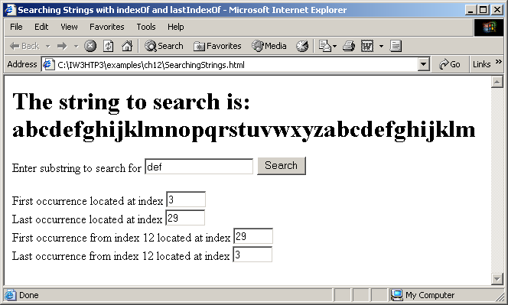
SearchingStrings
.html
3 of 3

Slide 20
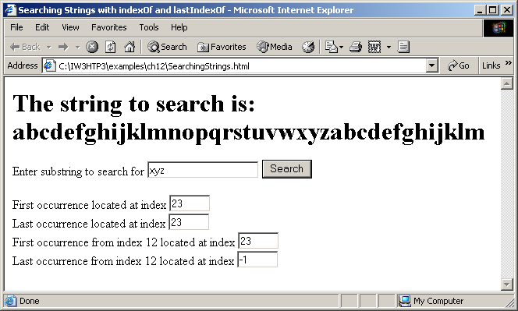

Slide 21
12.4.5 Splitting Strings and Obtaining Substrings
Tokenization
  The process of breaking a string into tokens
Tokens
  Individual words
  Separated by delimiters

Slide 22
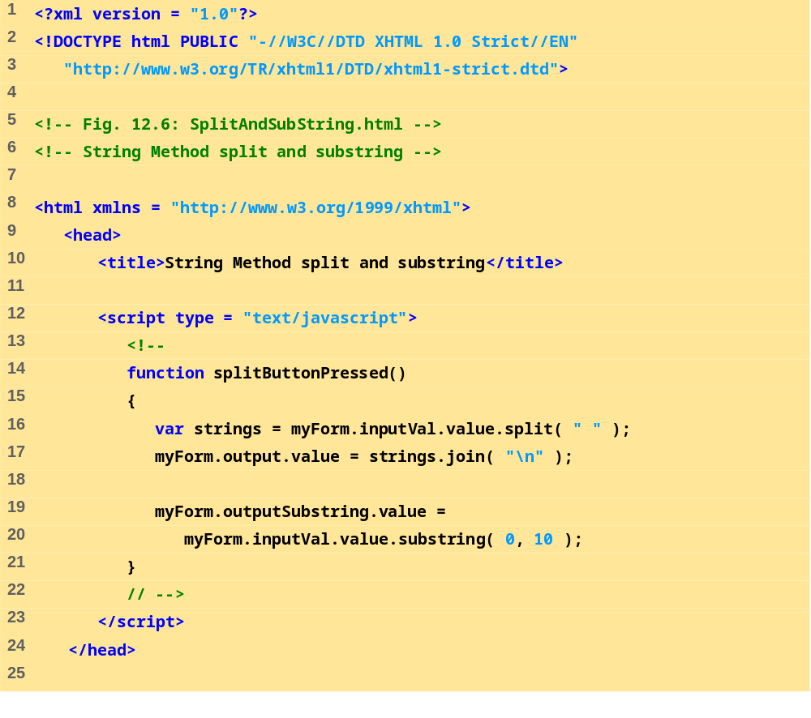
SplitAndSubString
.html
1 of 2

Slide 23
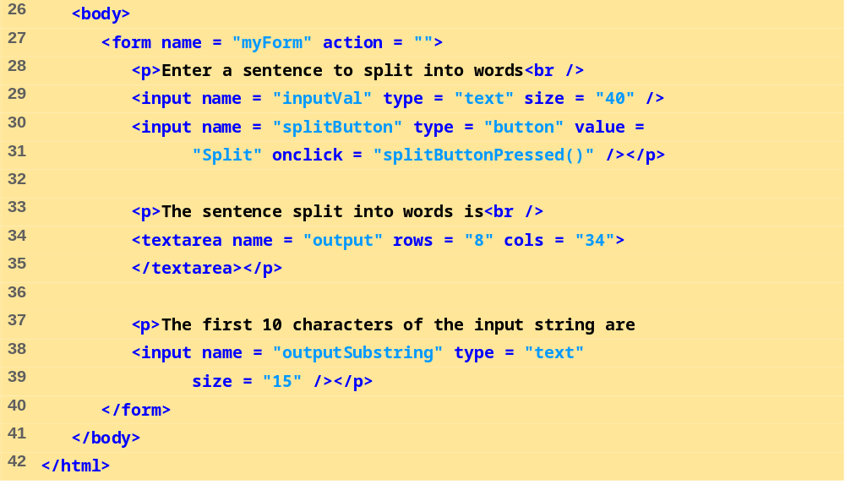
SplitAndSubString
.html
2 of 2

Slide 24
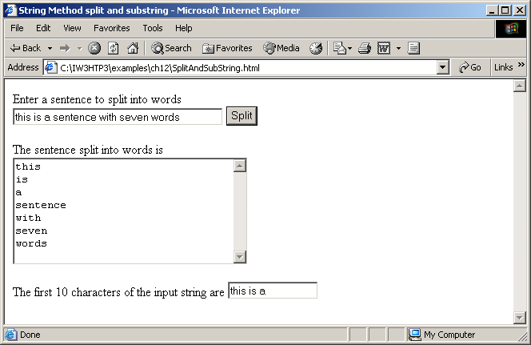

Slide 25
12.4.6 XHTML Markup Methods
Anchor
  <a name = “top”> Anchor </a>
Blink
  <blink> blinking text </blink>
Fixed
  <tt> monospaced text </tt>
Strike
  <strike> strike out text </strike>
Subscript
  <sub> subscript </sub>
Superscript
  <sup> superscript </sup>

Slide 26
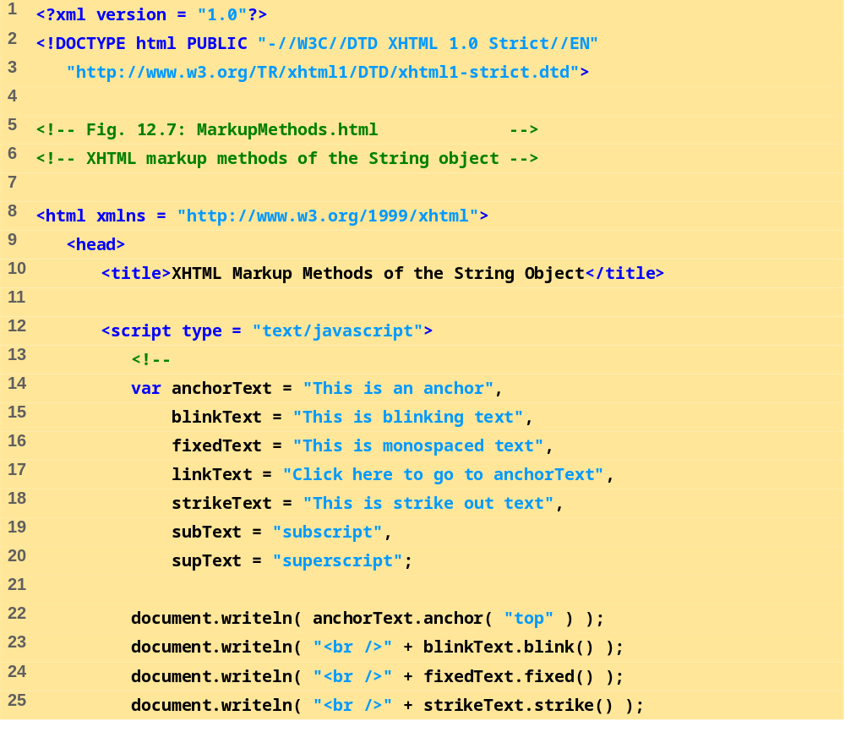
MarkupMethods.html
1 of 2

Slide 27
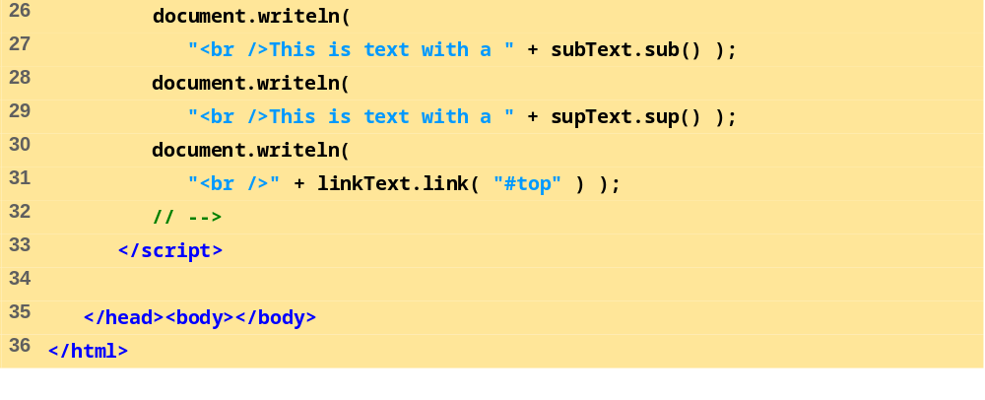
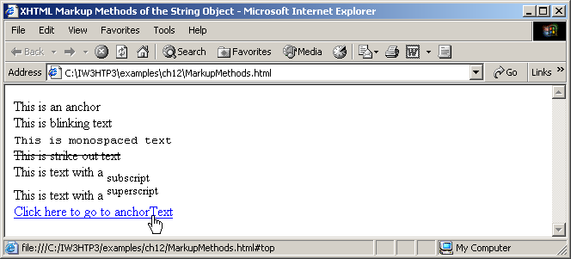
MarkupMethods.html
2 of 2

Slide 28
12.5 Date Object
Provides methods for date and time manipulations

Slide 29
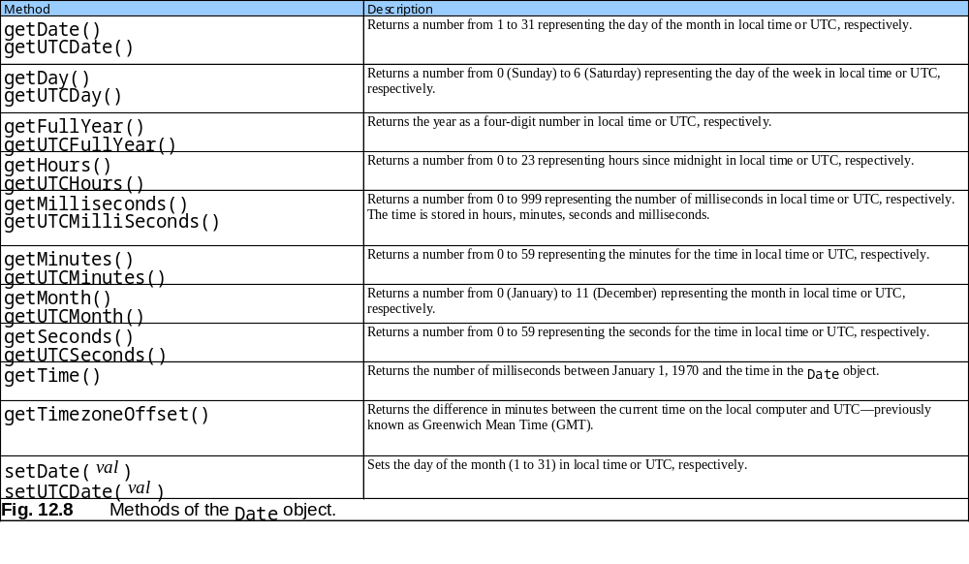
12.5 Date Object

Slide 30
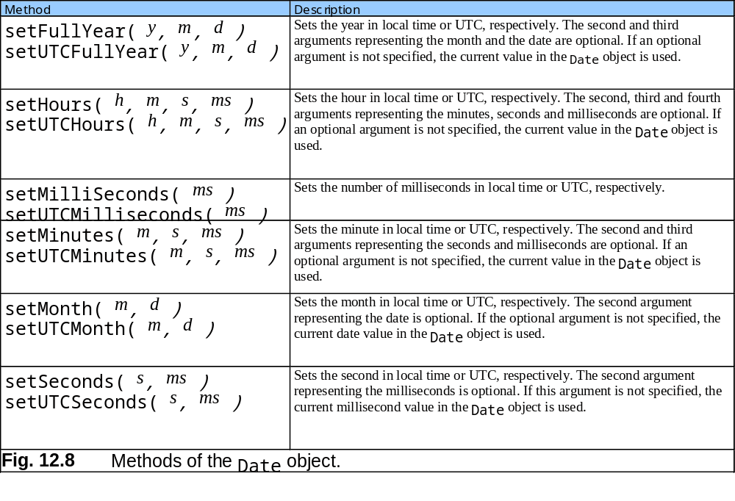
12.5 Date Object

Slide 31
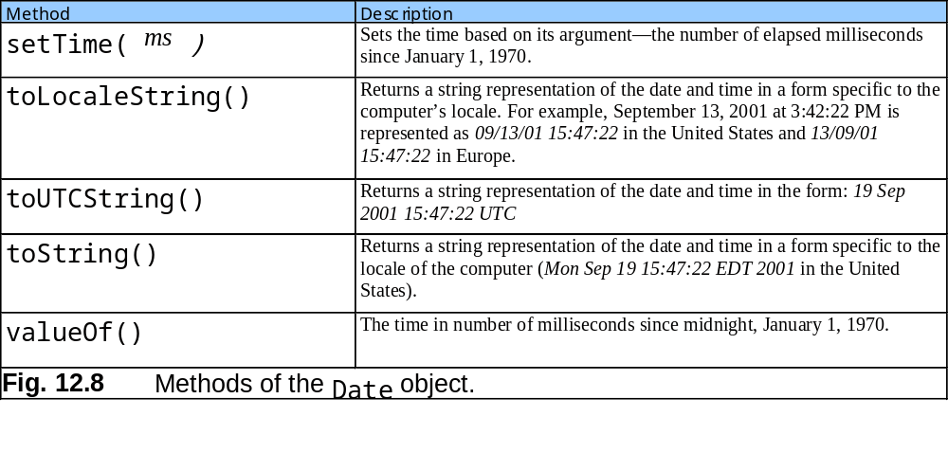
12.5 Date Object

Slide 32
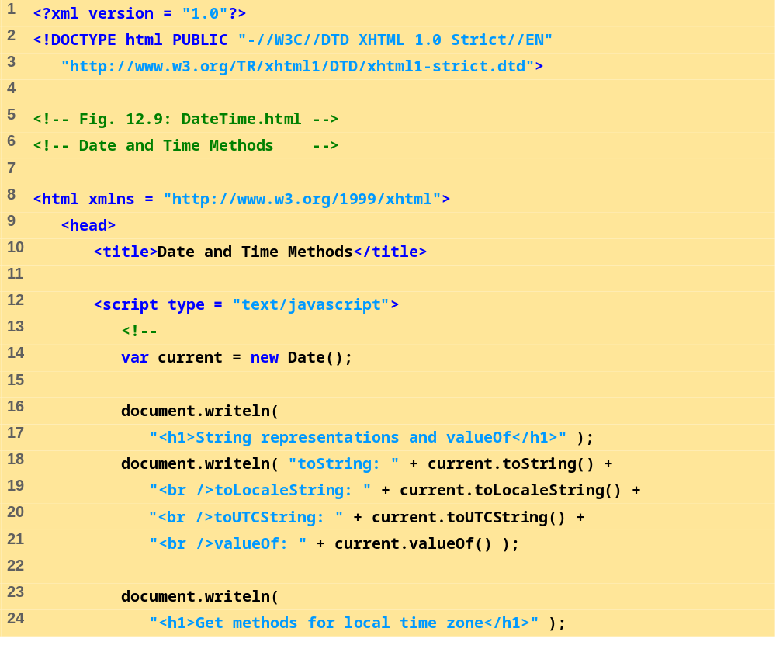
DateTime.html
1 of 3

Slide 33
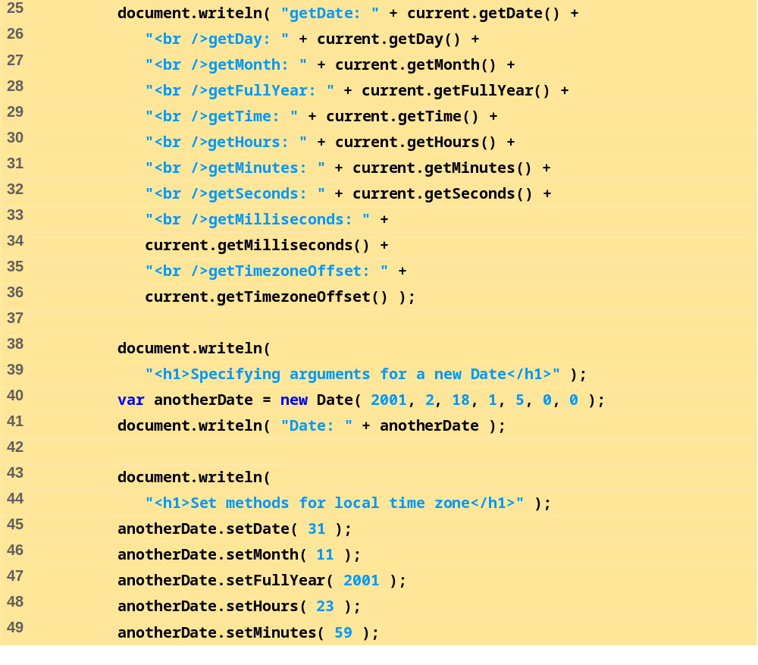
DateTime.html
2 of 3

Slide 34
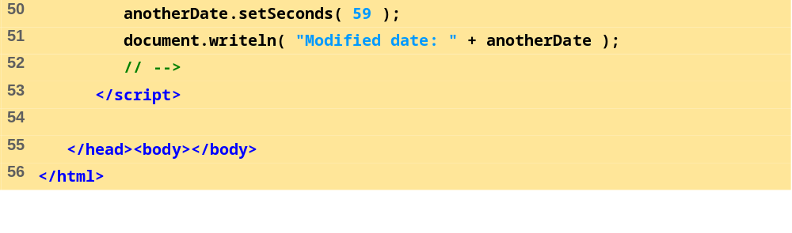
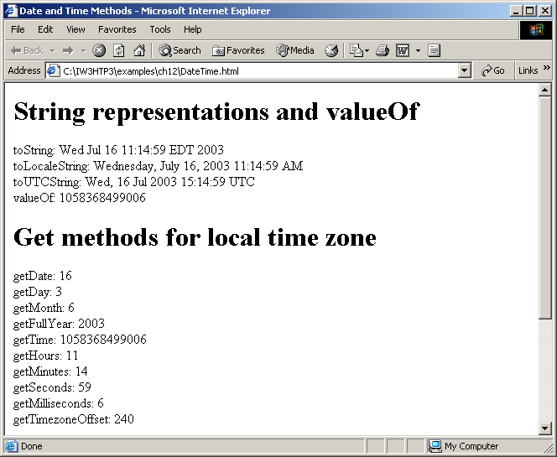
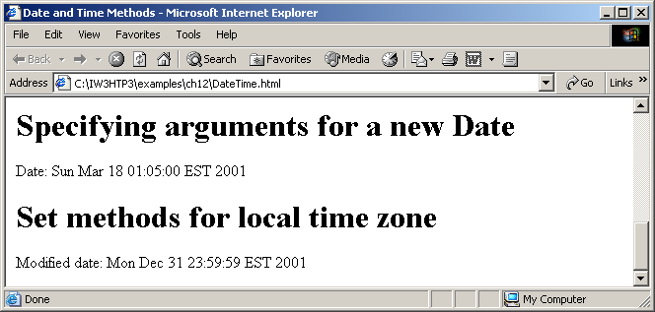
DateTime.html
3 of 3

Slide 35
12.6 Boolean and Number Objects
Object wrappers for boolean true/false values and numbers

Slide 36
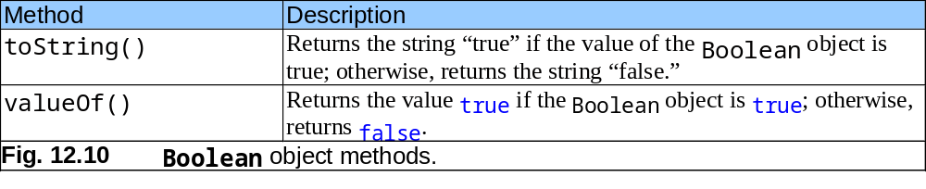
12.6 Boolean and Number Objects

Slide 37
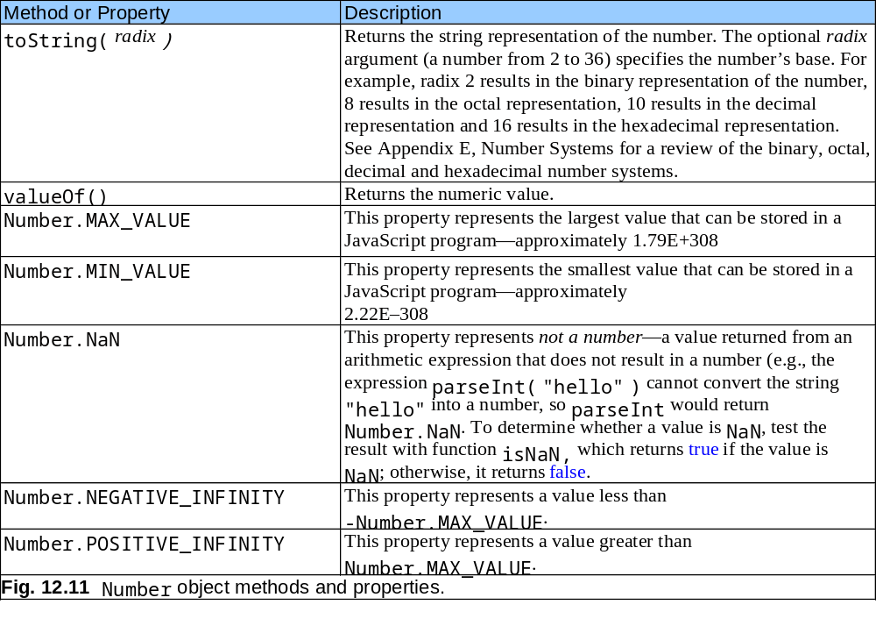
12.6 Boolean and Number Objects

Slide 38
12.7 document Object
Manipulate document that is currently visible in the browser window

Slide 39
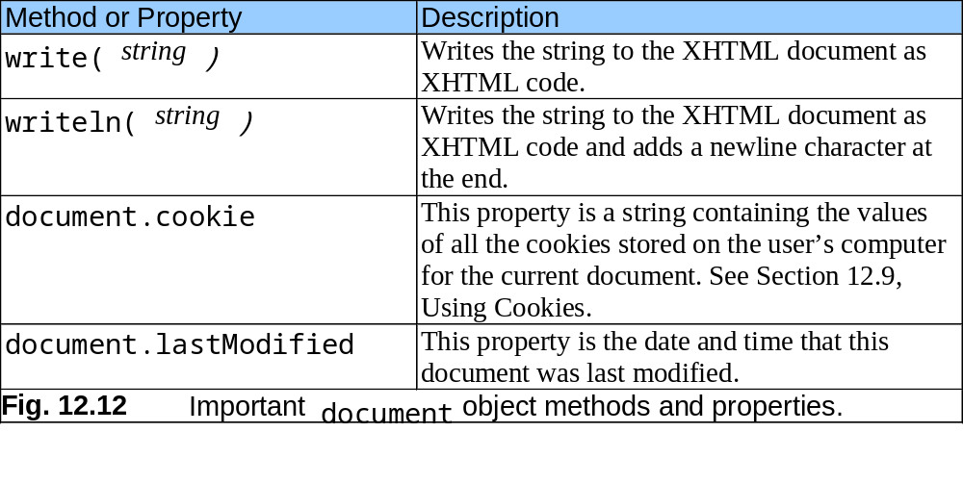
12.7 document Object

Slide 40
12.8 window Object
Provides methods for manipulating browser window

Slide 41
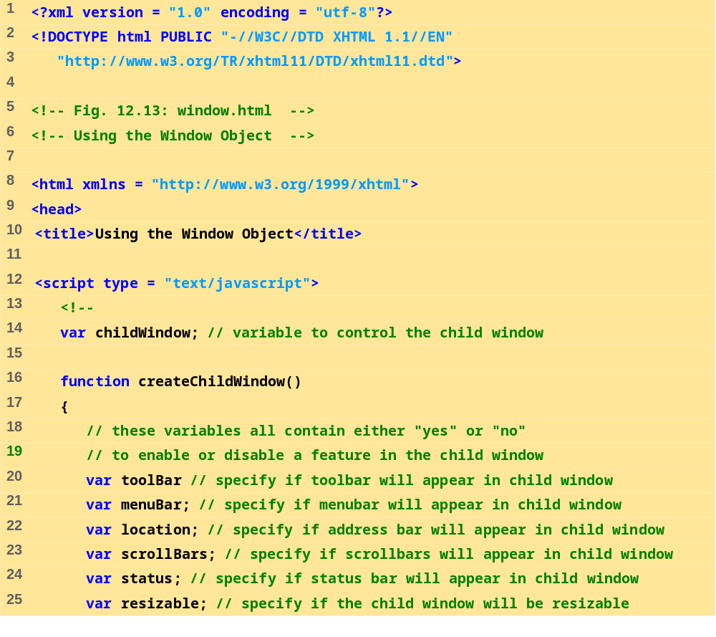
window.html
1 of 7

Slide 42
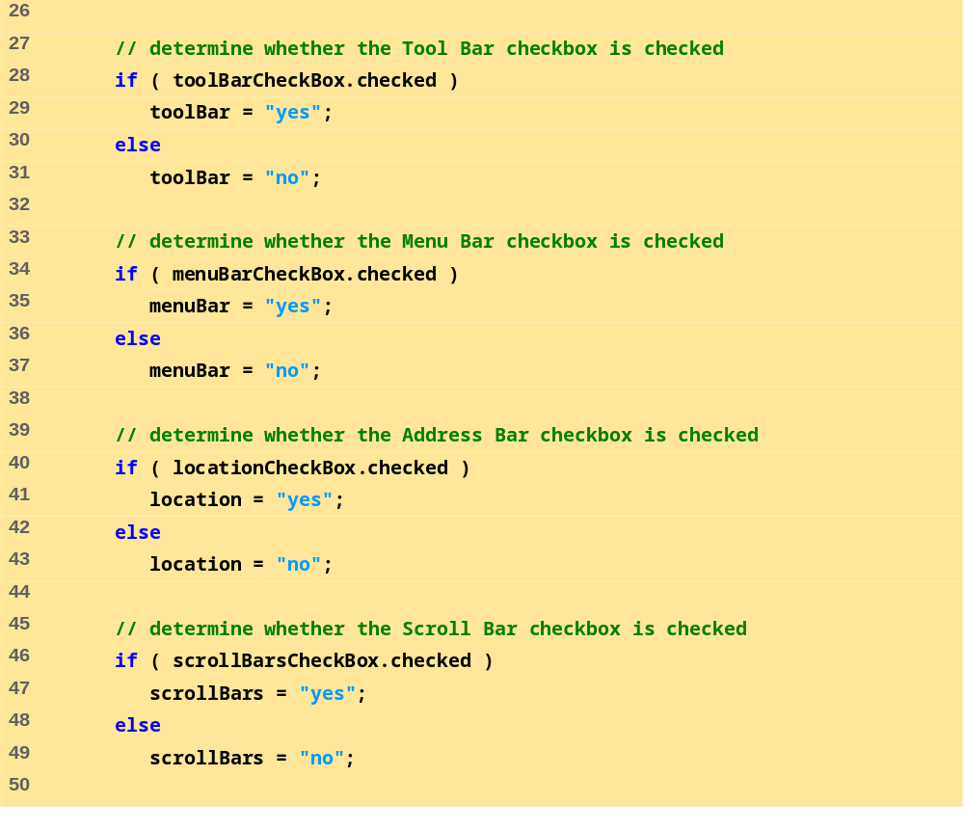
window.html
2 of 7

Slide 43
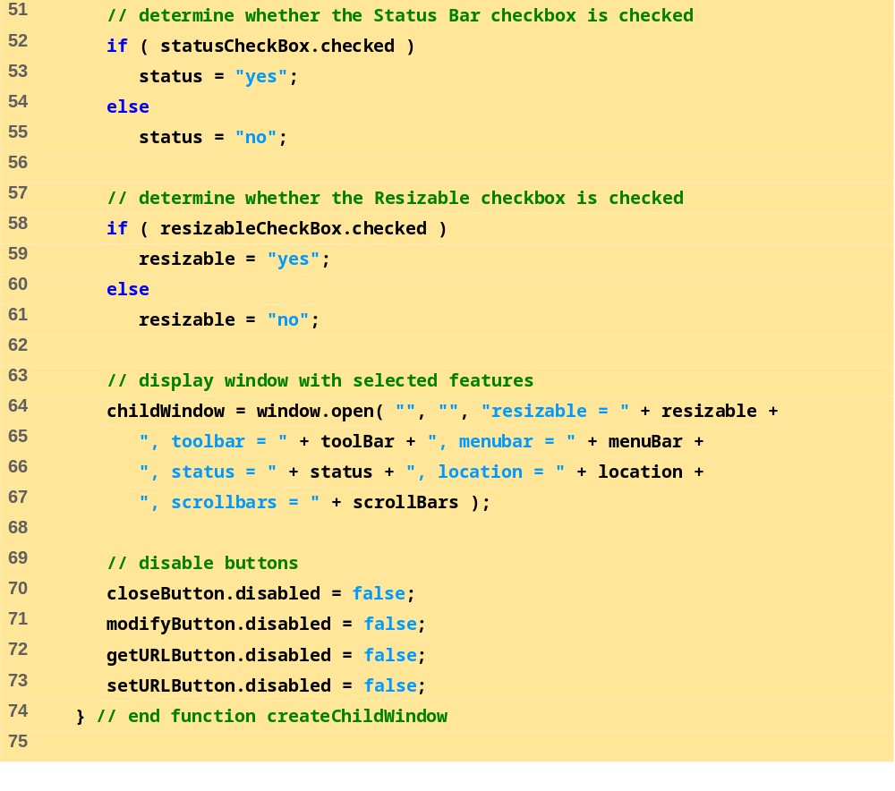
window.html
3 of 7

Slide 44
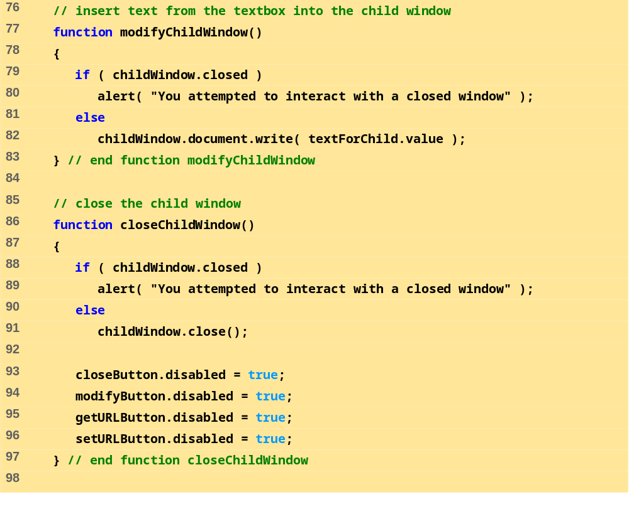
window.html
4 of 7

Slide 45
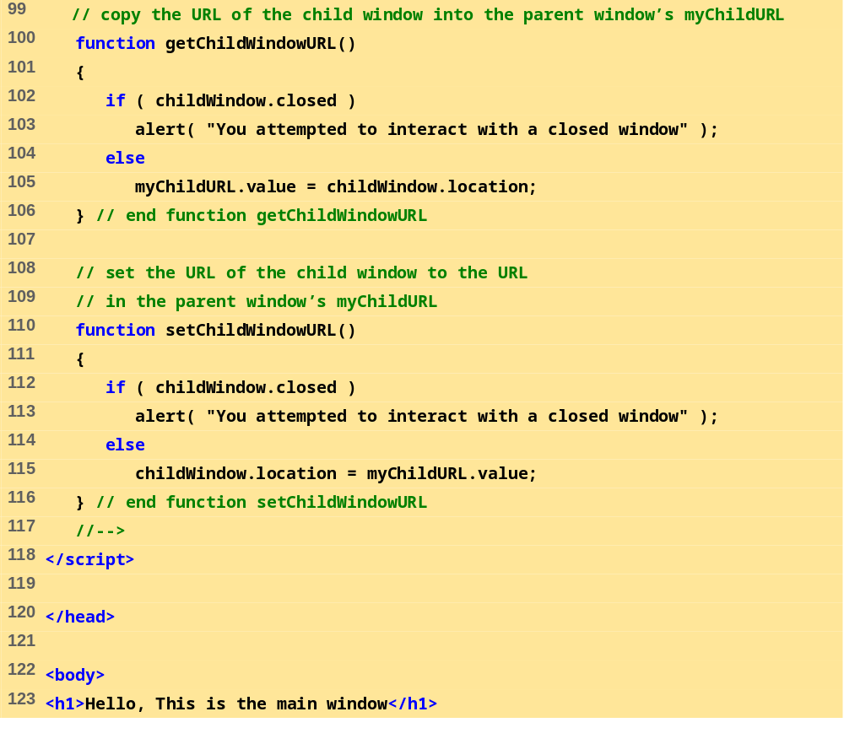
window.html
5 of 7

Slide 46
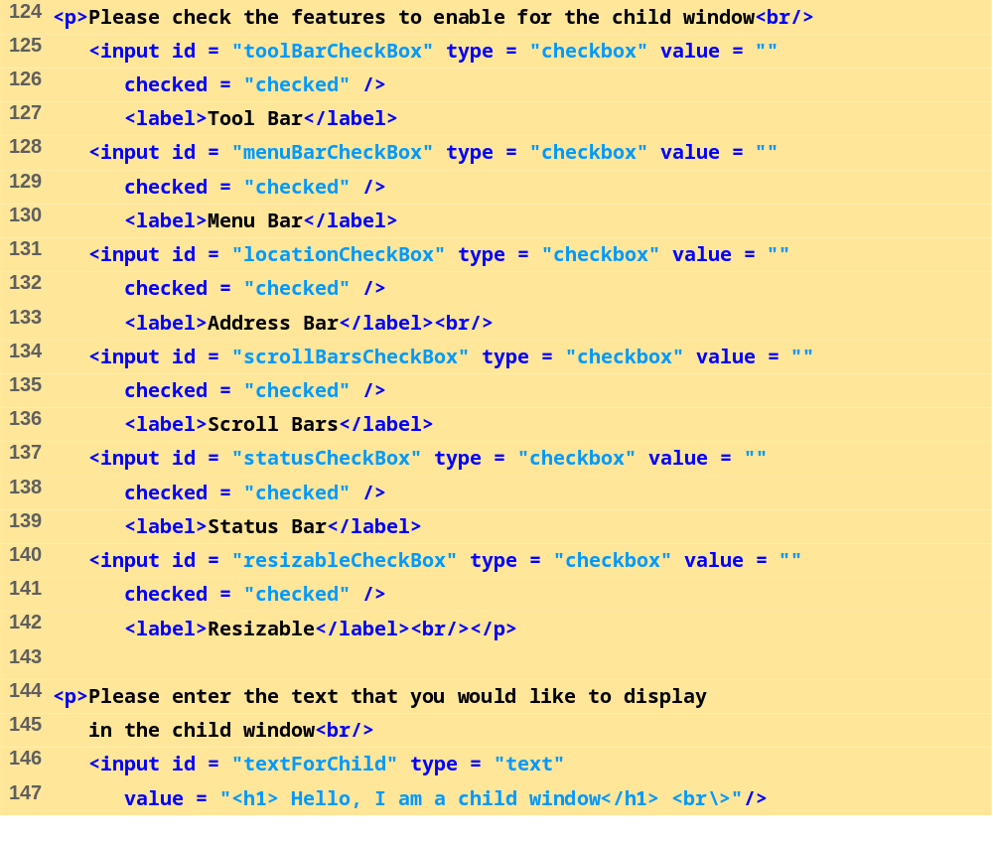
window.html
6 of 7

Slide 47
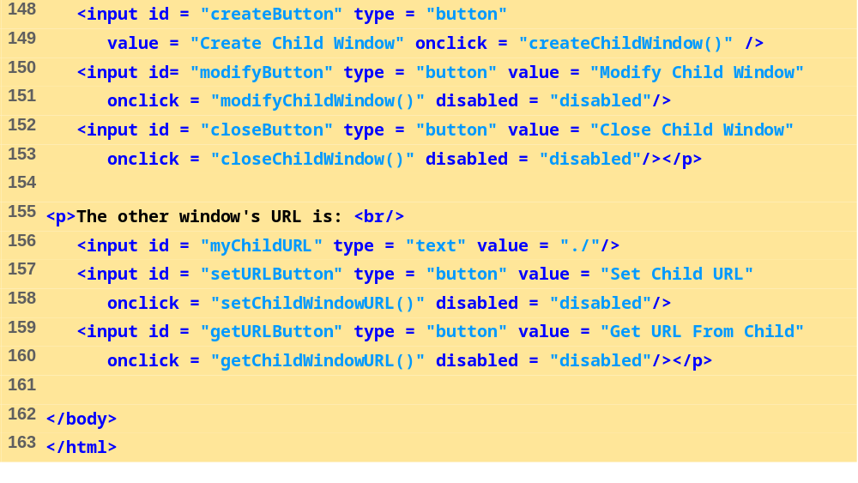
window.html
7 of 7

Slide 48
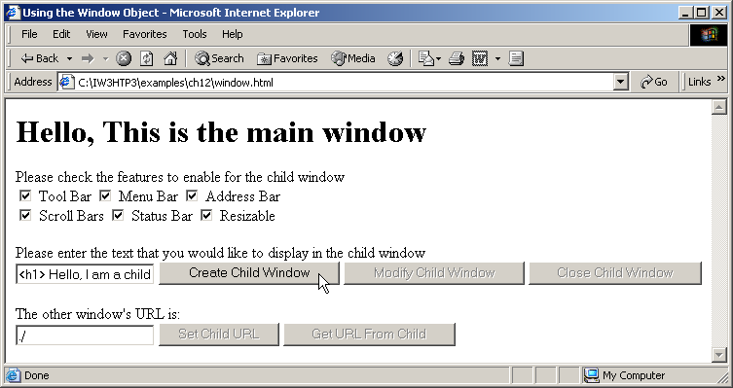
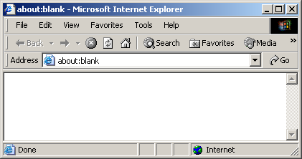

Slide 49
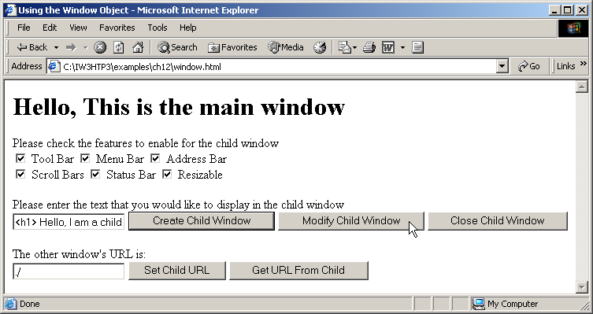
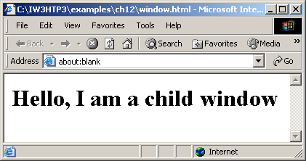

Slide 50
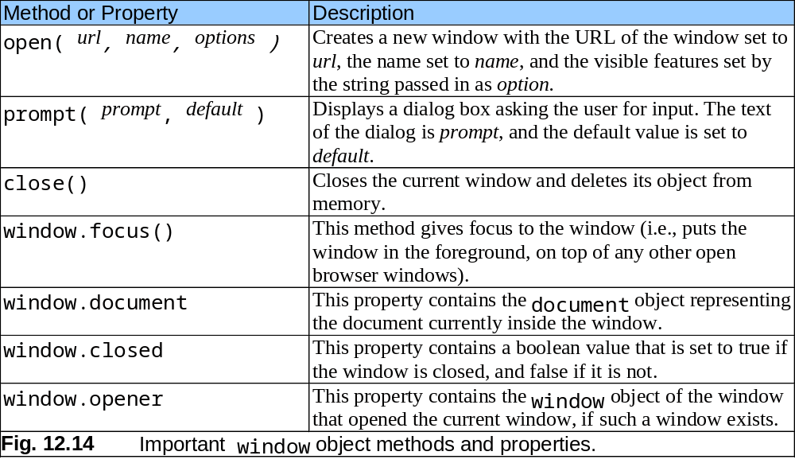
12.8 window Object

Slide 51
12.9 Using Cookies
Cookie
  Data stored on user’s computer to maintain information about client during and between browser sessions
  Can be accessed through cookie property
  Set expiration date through expires property
  Use escape function to convert non-alphanumeric characters to hexadecimal escape sequences
  unescape function converts hexadecimal escape sequences back to English characters

Slide 52
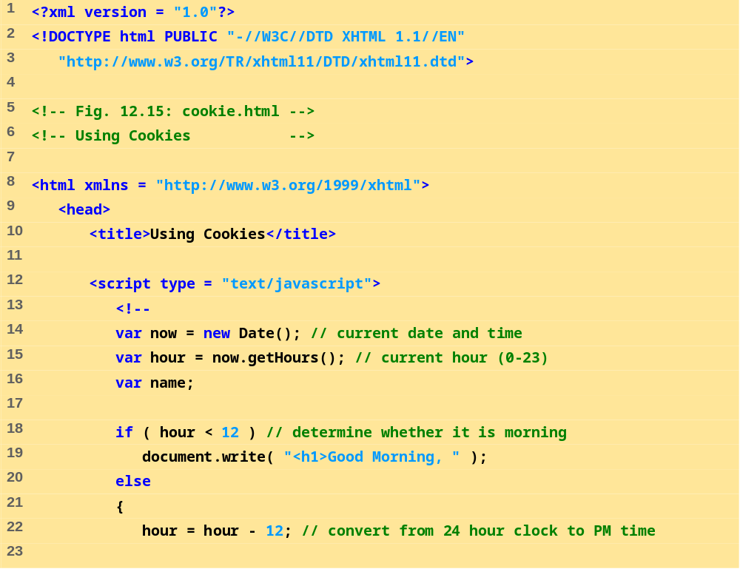
cookie.html
1 of 4

Slide 53
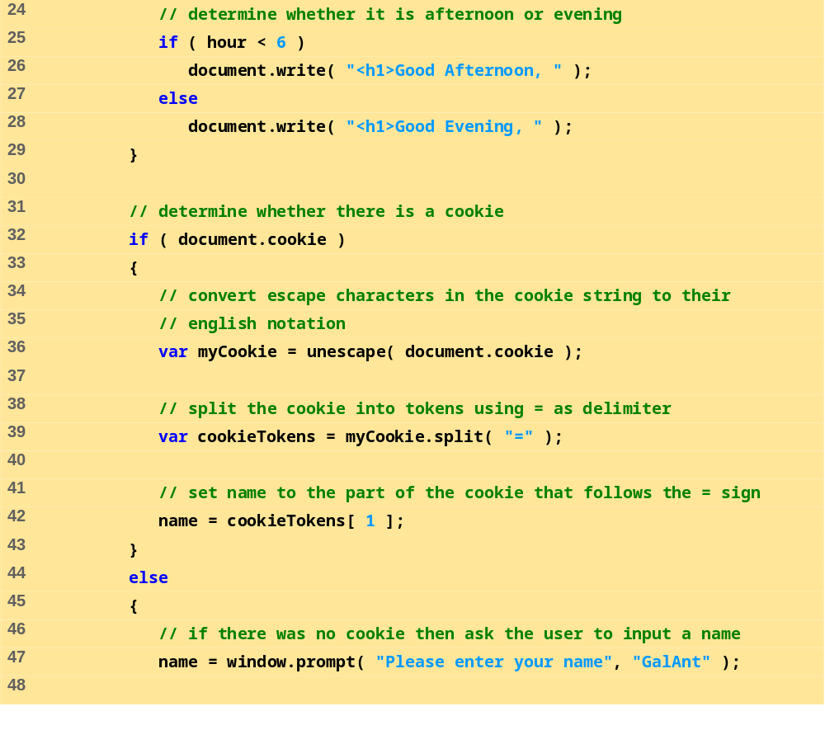
cookie.html
2 of 4

Slide 54
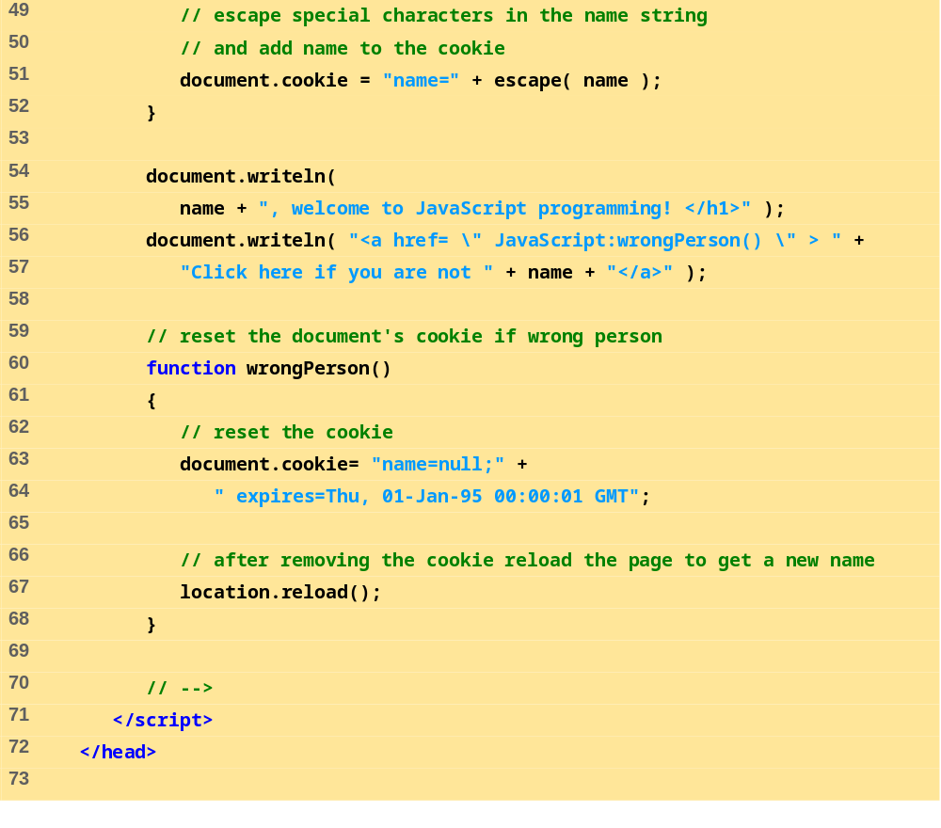
cookie.html
3 of 4

Slide 55
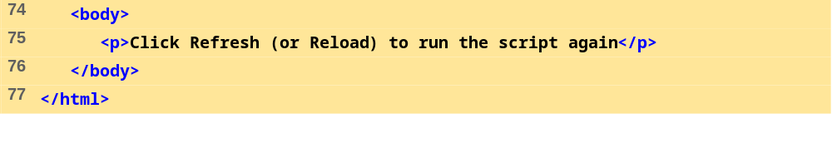
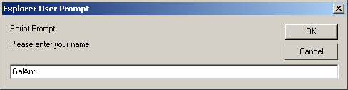
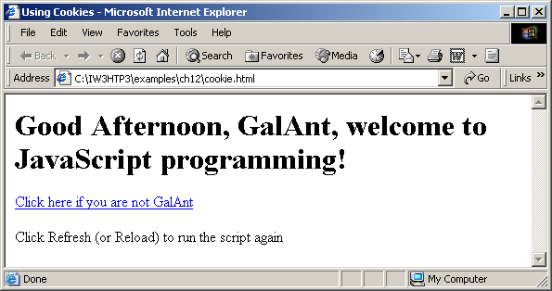
cookie.html
4 of 4

Slide 56
12.10 Final JavaScript Example
Combines concepts discussed previously

Slide 57
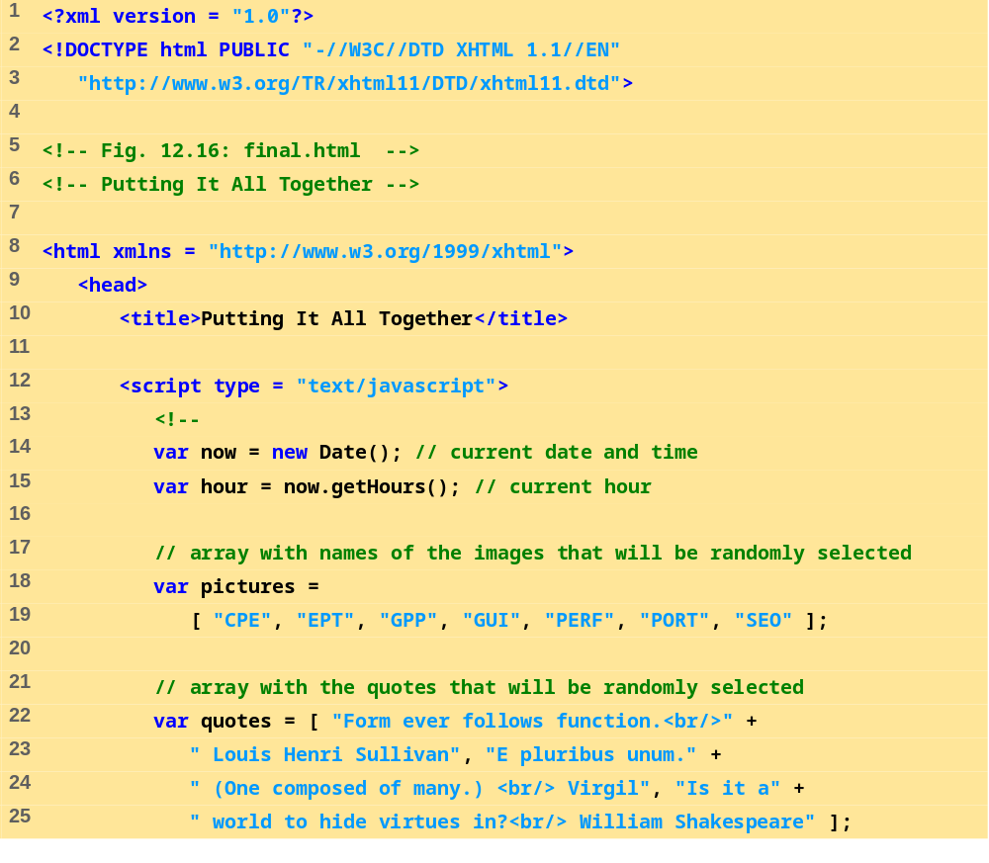
final.html
1 of 6

Slide 58

final.html
2 of 6

Slide 59

final.html
3 of 6

Slide 60

final.html
4 of 6

Slide 61

final.html
5 of 6

Slide 62

final.html
6 of 6

Slide 63



Slide 64

quiz2.html
1 of 3

Slide 65

quiz2.html
2 of 3

Slide 66


quiz2.html
3 of 3

Slide 67


Slide 68
12.11 Web Resources
www.javascript.com
www.iboost.com/build/programming/js/tutorial/885.htm
www.javascriptsearch.com
www.a1javascripts.com

